Slide 1
The Five Themes of Geography

Slide 2
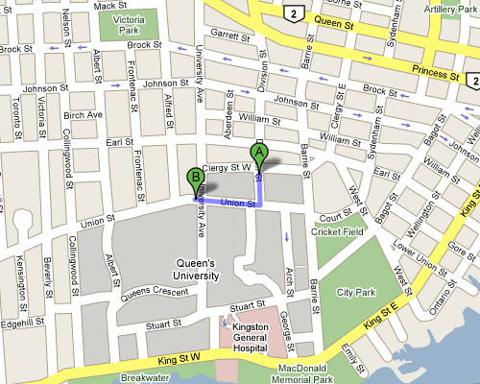
Location
Absolute location provides a definite reference to locate a place by using longitude and latitude or an address.
Relative location describes a place with respect to its environment and its connection to other places.

Slide 3
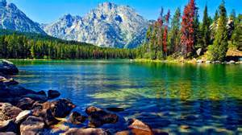
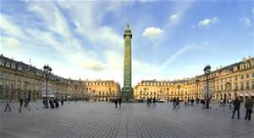
Place
Physical characteristics include a description such things as the landforms, bodies of water and animal/plant life of a place.
Human characteristics include architecture, jobs, religion, food and language.

Slide 4
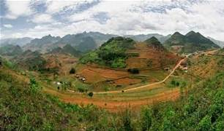
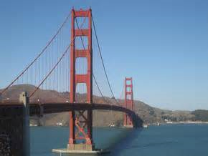
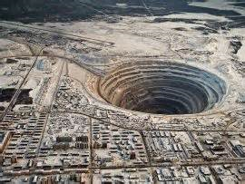
Interaction
How humans adapt to and modify the environment – can be both positive and negative.

Slide 5

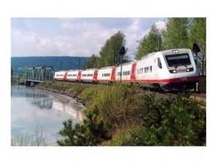
Movement
Ideas, fads, goods, resources, communication and humans all move around Earth!

Slide 6
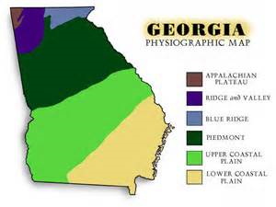
Region
This term can refer to specific areas such as a city or country, or can be general like “The South”.

Slide 7
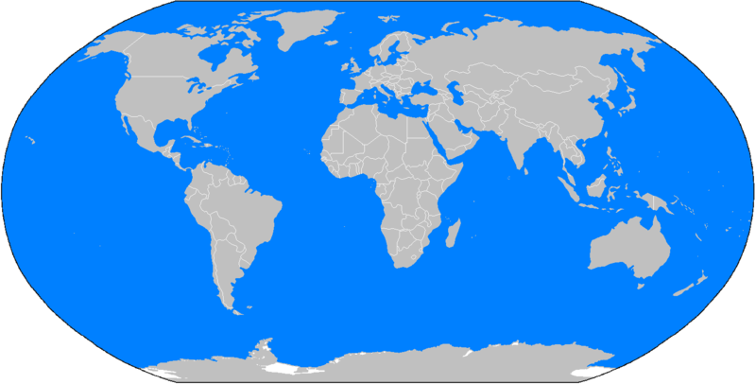
World map

Slide 8
Types of maps
Political – A map that shows boundaries of countries, state, counties, etc.
Physical – A map which shows landforms or bodies of water
Road – A map used by motorist to show roads and highways
Weather A map showing weather conditions such as temperature or rainfall

Slide 9
Features of Maps
Key – explanatory table of symbols
Scale - a ratio which compares a measurement on a map to the actual distance between locations identified on the map
Compass - an instrument for determining directions
Latitude - the angular distance north or south from the equator of a point on the earth's surface
Longitude - angular distance east or west on the earth's surface

Slide 10
Landforms & bodies of water
Cay
Landlocked
Channel
Plain
Canyon
Desert
Island
Peninsula
Mountain
Valley

Slide 11
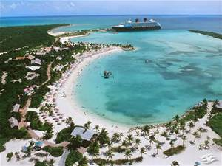
Cay
a small low island; key

Slide 12
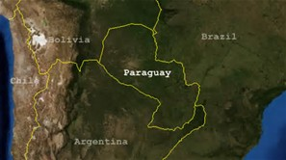
Landlocked
having no direct access to the sea

Slide 13
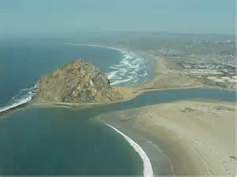
Channel
a navigable route between two bodies of water

Slide 14
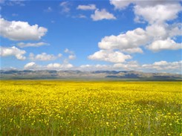
Plain
an area of land not significantly higher than adjacent areas

Slide 15
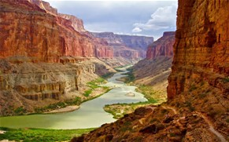
Canyon
a deep valley with steep sides, often with a stream flowing through it

Slide 16
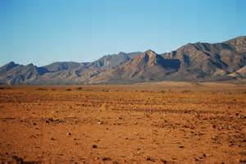
Desert
a region so arid because of little rainfall that it supports only sparse and widely spaced vegetation or no vegetation at all

Slide 17
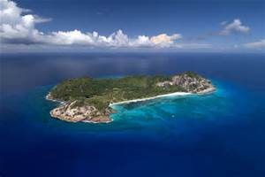
Island
a tract of land completely surrounded by water, and not large enough to be called a continent

Slide 18
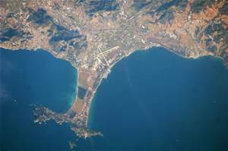
Peninsula
an area of land almost completely surrounded by water except for an isthmus connecting it with the mainland.

Slide 19
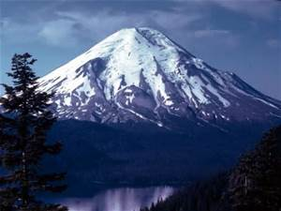
Mountain
a natural elevation of the earth's surface rising more or less abruptly to a summit, and attaining an altitude greater than that of a hill, usually greater than 2000 feet

Slide 20
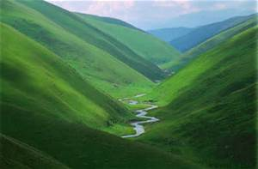
Valley
an elongated depression between uplands, hills, or mountains, especially one following the course of a stream

Slide 21
Pirate Map
Add to your map
  Key
  Scale
  Three landforms
  Where is it located?

